Slide 1
PULSE OXIMETER AND HEART RATE MONITORING SYSTEM
Group ID :- H9

Slide 2
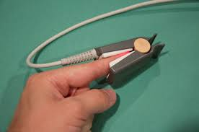
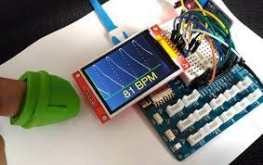
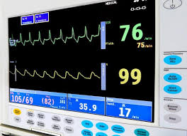
Introduction
Many further problems can be avoided if we could know heart rates and our oxygen saturation level at right time. In this project, we seek to monitor a persons heart rate using heart rate sensor and blood-oxygen level using a pulse oximeter. The system used here is the heart rate monitoring model, this can be used in almost all the hospitals as well as for general purposes like residential area. In this system, we have used pulse sensor to find the nearby or the actual value of heart beat rate of a normal person. Whenever problem arises in one’s heart functioning, in order to check the heart rate value this method is considered as the best method. When there is a low heart rate functioning happens, we call it as bradycardia. The lower of heart beat can be either a risky thing or sometimes it happens to normal person. Them main objective of our project is to provide a Simple and easy heart rate monitoring system and pulse oximeter so that it could be useful to everyone.

Slide 3

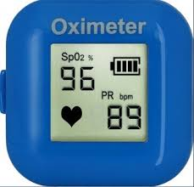

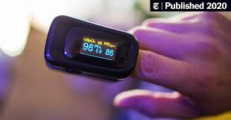
Objectives
The purpose is to examine how heart rate and the oxygen saturation of subject is measured from finger and then processed and displayed. The design, is small in size, easy to use, allows a non-invasive, real time method to provide information regarding health. Pulse oximetry is a useful tool in the evaluation of a patient's oxygenation status and may be used routinely in many areas of clinical practice. The Heart Rate Monitoring system’s objective is of detecting the heart beat of the patient in order to monitor the risk of heart attack and also the regular checkup. The data received from heart rate module and blood oxygen sensor can be saved and viewed for further medical usage.

Slide 4

Literature Review
R.K. Parate, Design a Portable Health Monitoring System Based on Node MCU. The designed system helped to achieve portability, high functionality and low cost which makes it an easy accessible tool for public, hospital, sports healthcare and other medical purposes.
Rahman, Atanutarai,et . develop a Device for Remote monitoring of both heart rate and Body temperature. The system has been tested and valid for some bio signal such as heart rate and body temperature.The bio signals are measured in real time with a higher correctness.
Khalifa AlSharqi develop a Zigbee Based Wearable Remote Healthcare Monitoring System for Elderly Patients. The system can provide tangible time online information about the health condition of a patient and also send alarming messages to the healthcare specialized about the patients.
Prof. Sunil L. Rahane,Prof. RameshS.Pawase. develop a Healthcare Monitoring System Using Wireless Sensor Network with GSM. Design of healthcare monitoring system makes using WSN with GSM modem. In this system sensor node measures blood pressure, temperature , Respiration ,Electrocardiogram and heart rate.

Slide 5
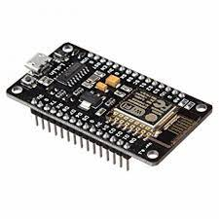
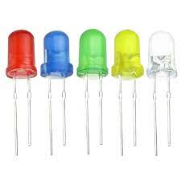
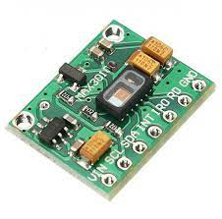
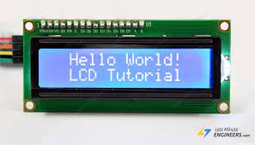
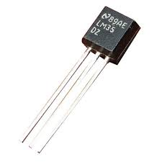
Tools and components used
NODE MCU
LED’s
MAX30102
Liquid crystal display l2C
LM35 sensor

Slide 6


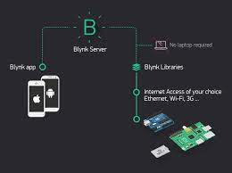




Software components
Blynk server
CSS
HTML
Tinkercad
Arduino IDE
IFTTT
000webhost

Slide 7
Methodology Implemented
Selection unit
Display Unit
Push Buttons
Serial Monitor
(For Debugging)
Temperature sensor
(LM35)
NODE MCU
Embedded Processing Unit
LCD Module
This project is about Heart rate and pulse oxygen monitoring using
MAX30102 which is a integrated heart beat rate and blood oxygen
sensor. MAX30102 includes internal LEDs, photodetectors, optical
elements, and low-noise electronics with ambient light rejection. O
-ur system also measures body temperature using the LM35 sensor.
LM35 series is a precision integrated-circuit temperature devices
with an output voltage linearly proportional to the Centigrade temp
-erature. The data from MAX 30102 and LM35 sensor is collected
by NodeMCU which is an open source IoT platform. NodeMCU
includes a firmware which runs on ESP8266 WIFI SoC and hardware based on Esp-12 module. The NodeMCU further processes this data and helps displaying this data on LCD display. We can also see this data on the serial monitor, locally running IoT webpage, Blynk server and mobile app.
Pulse Oximeter and heart rate sensor(MAX30102)
Iot webpage
Blynk
Sensing Unit
Buzzer
LED
Alarm Unit

Slide 8


Future Scope
In near future, Whenever there is a rise in the heart rate, we can connect this module to the emergency alert to the nearby hospital ambulance. This system can further be upgraded to measure other health factors such as blood pressure, sugar etc. making it a overall health monitoring system.

Slide 9

Group Members
Roll No. 46 Ganesh Karode
Roll No. 47 Omkar Karpe
Roll No. 48 Kartik Rupauliha
Roll No. 49 Kartik Rajput
Roll No. 50 Nakul Kasar
THANKYOU…!

